Slide 1

UECS3213 / UECS3453 Data Mining Topic 4: Regression Analysis
Dr. Simon Lau Boung Yew

Slide 2
Outline
What is a model?
Deterministic Models
Probabilistic Models
Regression model
Correlation
Correlation vs Regression
What is regression?
Simple Linear Regression
Model Assessment
Multiple Linear Regression
Logistic Regression

Slide 3

What is a model?
Representation of some real-world phenomenon
Notes:
.

Slide 4
What is a Mathematics/Statistical Model?
Often describe relationship between variables (X, Y)
Types
Deterministic Models (no randomness)
Probabilistic Models (with randomness)
Notes:
.

Slide 5
Deterministic Models
Hypothesize exact relationships
Suitable when prediction error is negligible
Example: Body mass index (BMI) is measure of body fat based
Metric Formula: BMI = Weight in Kilograms (Height in Meters)²
Non-metric Formula: BMI = Weight (pounds)x703
(Height in inches)²

Slide 6
Probabilistic Models
Hypothesize 2 components
Deterministic + random error
Example: Systolic blood pressure of newborns is 6 times the age in days + random error
SBP = 6 x age(d) + Ꜫ
Random error may be due to factors other than age in days (e.g. birthweight)

Slide 7
Types of Probabilistic Models
Notes:
7

Slide 8
Correlation Model

Slide 9
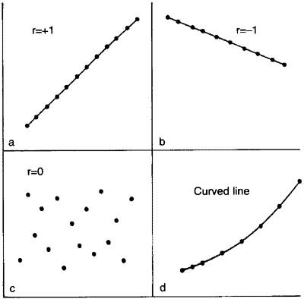
Correlation Model
Questions:
Is there a relationship between A and B?
Example: Is there a relationship between the number of employee training hours and the number of on-the-job accidents?
A correlation is a relationship between two variables.
We take x to be the independent variable. We take y to be the dependent variable. Data is represented by a collection of ordered pairs (x, y).

Slide 10
Correlation
The strength and direction of a linear relationship between two variables is represented by the correlation coefficient, r
This will always be a number between [-1, 1](inclusive).

Slide 11
Interpreting the Correlation Between Two Variables
There could be a direct cause-and-effect relationship:
x causes y
There could be a reverse cause-and-effect relationship: that is, y causes x.
There could be a third (or fourth? or more?) variable that leads to the relationship between x and y.
The “relationship” between x and y may just be a coincidence.

Slide 12
Regression Models
Notes:
13

Slide 13
What is regression?
Regression is the attempt to explain the variation in a dependent variable using the variation in independent variables.
Regression is thus an explanation of causation.
Relation between variables where changes in some variables may “explain” or possibly “cause” changes in other variables.
Explanatory variables are termed the independent variables (regressor, predictor, explanatory) (e.g. x) and the variables to be explained are termed the dependent variables (e.g. y).

Slide 14
Regression Model
If the independent variable(s) sufficiently explain the variation in the dependent variable, the regression model can be used for prediction.
Change in dependent variables that results from changes in independent variables, i.e. size of the relationship.
Strength of the relationship (positive? negative?)
Statistical significance of the relationship.

Slide 15
Correlation vs Regression
Correlation and regression are the two analysis based on multivariate distribution: a distribution of multiple variables.
Correlation is described as the analysis which lets us know the association or the absence of the relationship between two variables ‘x’ and ‘y’. (x related to y?)
Regression analysis predicts the value of the dependent variable based on the known value of the independent variable, assuming that average mathematical relationship (model) between two or more variables. (Given x, what is y? Change x by α, how much is the change in y?)
Notes:
https://keydifferences.com/difference-between-correlation-and-regression.html
https://www.bmj.com/about-bmj/resources-readers/publications/statistics-square-one/11-correlation-and-regression

Slide 17
Regression Modeling Steps
Hypothesize deterministic component
Estimate unknown parameters, x, y
Specify probability distribution of random error term, Ꜫ
Estimate standard deviation of error
Evaluate the fitted model (training)
Use model for prediction & estimation (testing)

Slide 18
Specifying the deterministic component
Define the dependent variable and independent variable
Hypothesize nature of relationship (model)
Expected effects (i.e., coefficients’ signs, +/-)
Functional Form (Linear or Non-Linear)
Interactions
Model specification is based on theory
Theory of Field (e.g., Epidemiology)
Mathematical Theory
Previous Research
‘Common Sense’

Slide 19
Linear Regression
Regression analysis describes the relationship (linear/non-linear) between two (or more) variables.
Linear dependence: constant rate of increase of one variable with respect to another (as opposed to, e.g. diminishing returns).
Examples:
Income and educational level
Demand for electricity and the weather
Home sales and interest rates

Slide 20
Two main questions:
Prediction and Forecasting
Predict home sales (Y) for December given the interest rate for this month (X).
Use time series data (e.g., sales vs. year) to forecast future performance (next year sales).
Predict the selling price of houses in some area.
Collect data on several houses (# of bedroom, # of bathroom, sq.ft, lot size, property tax) and their selling price.
Can we use this data to predict the selling price of a specific house?
Quantifying Causality
Determine factors that relate to the variable to be predicted; e.g. predict growth for the economy in the next quarter by using past history on quarterly growth, index of leading economic indicators, and others.
Want to determine advertising expenditure and promotion for the Ford Explorer. Sales over a quarter might be influenced by ads in print, ads in radio, ads in TV, and other promotions.

Slide 21
More Examples
Dependent variable is retail price of gasoline vs. independent variable is the price of crude oil.
Dependent variable is employment income vs. independent variables might be hours of work, education, occupation, sex, age, region, years of experience, unionization status, etc.
Price of a product vs. quantity produced or sold:
Quantity sold affected by price
Dependent variable is quantity of product sold vs. independent variable is price.
Price affected by quantity offered for sale
Dependent variable is price vs. independent variable is quantity sold.

Slide 22
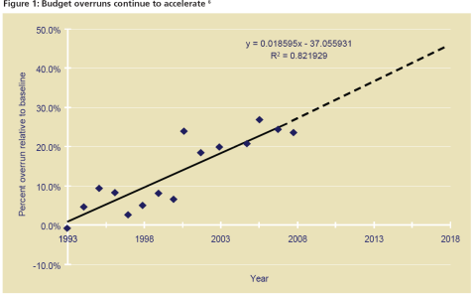
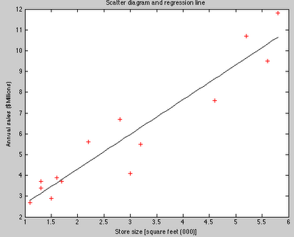
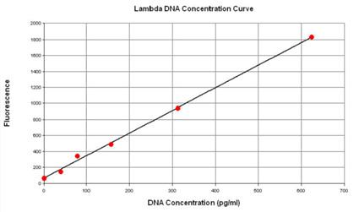
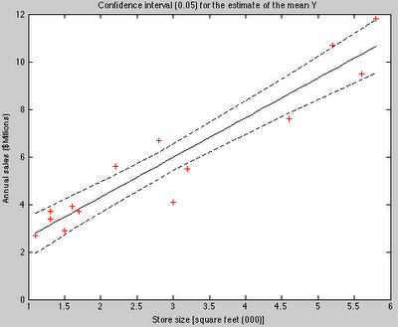
Linear Regression Analysis: Examples

Slide 23
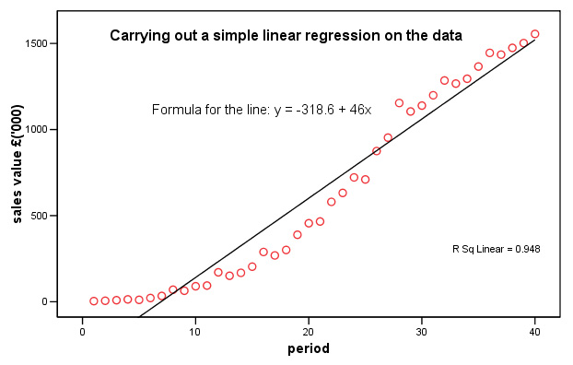
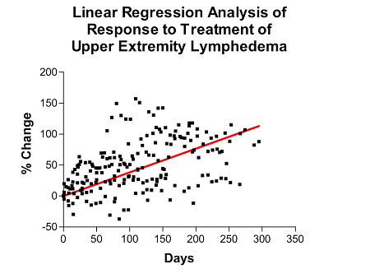
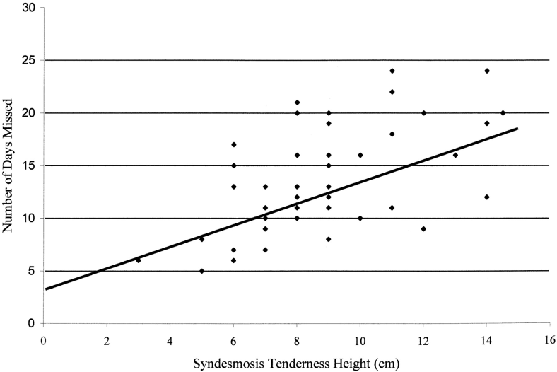
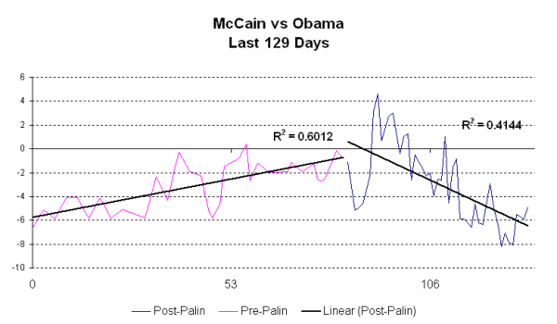
Linear Regression Analysis: Examples

Slide 24
Types of Regression Models
1 Explanatory
Regression
2+ Explanatory
Variable
Models
Variables
A simple linear regression model: consider a model with only one independent variable.
A multiple linear regression model: a model with multiple independent variables.
Simple
Multiple
Non-
Non-
Linear
Linear
Linear
Linear
Notes:
24
This teleology is based on the number of explanatory variables & nature of relationship between X & Y.

Slide 25
Simple Linear Regression

Slide 26
Linear Equation
© 1984-1994 T/Maker Co.
Notes:
28

Slide 27
Linear Deterministic Regression Model
Our deterministic linear regression model assumes that
E(Y|X = x) = β₀ + β₁x (1)
where:
when X (e.g. house size) is fixed at a level x, then we assume the mean of Y (e.g. selling price) to be linear around the level x, where
β₀ is the (unknown) intercept and β₁ is the (unknown) slope or incremental change in Y per unit change in X.
β₁ is the per unit change (gradient or slope) in the dependent variable for each unit change in the independent variable. β₁ =
β₀ and β₁ are not known exactly, but are estimated from sample data. Their estimates are denoted b₀ and b₁. (regression)

Slide 28
Linear Probabilistic Regression Model
Relationship between variables is a linear function
Y-Intercept
Random Error
Slope
y
=
β
+
β
x
+
ε
i
0
1
i
i
Dependent (Response) Variable
Independent (Explanatory) Variable

Slide 29
House Number | X: House Size (100s ft2) | Y: Actual Selling Price ($1,000s)
1 | 20.0 | 89.5
2 | 14.8 | 79.9
3 | 20.5 | 83.1
4 | 12.5 | 56.9
5 | 18.0 | 66.6
6 | 14.3 | 82.5
7 | 27.5 | 126.3
8 | 16.5 | 79.3
9 | 24.3 | 119.9
10 | 20.2 | 87.6
11 | 22.0 | 112.6
12 | .019 | 120.8
13 | 12.3 | 78.5
14 | 14.0 | 74.3
15 | 16.7 | 74.8
Averages | 18.17 | 88.84
Sample 15 houses from the region.

Slide 30
Simple Linear Regression
The output of a regression is a function that predicts the dependent variable based upon values of the independent variable.
Simple regression fits a straight line to the data.

Slide 31
Simple Linear Regression
The function will make a prediction for each observed data point.
The observation is denoted by y and the prediction is denoted by .

Slide 32
Simple Linear Regression
For each observation, the variation can be described as:

Slide 33
Least Square Method
The least square method is a procedure that is used to find the line (regression line) that provides the best approximation for the relationship between x and y.

Slide 34
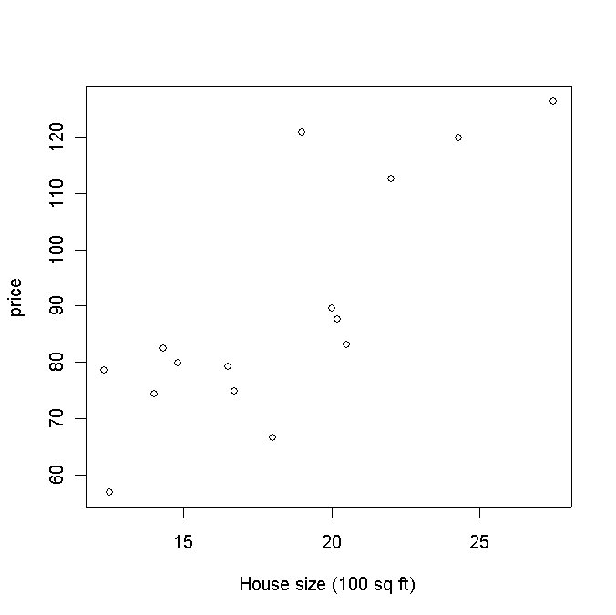
Least Squares Estimation
How would you draw a line through the points? How do you determine which line ‘fits best’?
Scatter Plot
Plot of All (X_{i}, Y_{i}) Pairs
Suggests How Well Model Will Fit
Y_{i}: price <-c(89.5,79.9,83.1,56.9,66.6,82.5,126.3,79.3,119.9,87.6,112.6,120.8,78.5,74.3,74.8)
X_{i}: House size<- c(20.0,14.8,20.5,12.5,18.0,14.3,27.5,16.5,24.3,20.2,22.0,19.0,12.3,14.0,16.7)
plot(X = “House size (100 sq ft)”, Y =“Selling price ($1,000)”)

Slide 35
Three Scenarios

Slide 36
Least Squares Estimation: Assumptions
These data do not form a perfect line. This is not surprising, considering that our data are random (probabilistic).
In other words, if we assume equation (1) then our line predicts the mean for any given level x.
However, when we actually take a measurement (i.e., observe the data), we observe (randomness):
Y_{i} = β₀ + β₁X_{i} + ε_{i}, for i = 1,2,…, n = 15, (equation 1)
where ε_{i} is the random error associated with the ith observation.
Since we don't know the true values of β₀ and β₁, it is clear that we do not observe the actual errors (ε_{i}) precisely either.

Slide 37
Assumptions about the Error
The errors are independent, that is, the error in the ith observation is independent of the error observed in the jth observation.
The ε_{i} are normally distributed (with mean 0 and standard deviation σ_{ε}).
E(ε_{i} ) = 0 for i = 1, 2,…,n.
σ(ε_{i} ) = σ_{ε} where σ_{ε} is unknown. (+/-)

Slide 38
Sum of Squares of Error (SSE)
A least squares regression selects the line with the lowest total sum of squared prediction errors.
This value is called the Sum of Squares of Error, or SSE.

Slide 39
Least Squares
‘Best Fit’ means difference between actual y values & predicted values are a minimum but positive differences off-set negative. So square errors!
Least Square (LS) minimizes the Sum of Squares of Error, or SSE.
Notes:
51

Slide 40
Standard Error of Estimate
The Standard Error of Estimate of a regression is a measure of its variability.
Standard Error is calculated by taking the square root of the average prediction error.
where n is the number of observations in the sample and k is the total number of variables in the model

Slide 41
Calculating SSR
The Sum of Squares Regression (SSR) is the sum of the squared differences between the prediction for each observation and the population mean.

Slide 42
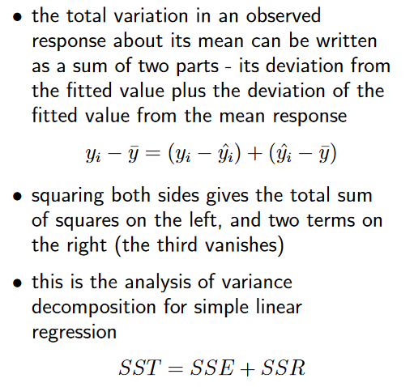
The Analysis of Variance for Simple Linear Regression
Notes:
More here: https://www.mathstat.dal.ca/~stat2080/Fall14/Lecturenotes/corregnew3.pdf

Slide 43
Regression Formulas
Total Sum of Squares (SST) = SSR + SSE.
Mathematically,
Regression sum of squares
Residual sum of squares
Notes:
http://www.public.asu.edu/~gwaissi/ASM-e-book/module208.html

Slide 44
Goodness of Fit of the Regression Line
The proportion of total variation (SST) that is explained by the regression (SSR) is known as the Coefficient of Determination, R.
The value of R can range between 0 (nothing is explained) and 1 (all points must lie on a straight line), and the higher its value the more accurate the regression model is. It is often referred to as a percentage.
For simple linear regression R² = r² (just the square of the (Pearson) correlation coefficient)
This is the proportion of variation in y explained by the regression on x

Slide 45
Applications
Finance & Economy: GDP, oil prices or stock prices
Sports: predict the number of runs or goals a player would score in the coming matches based on previous performances.
Commerce: predict the sale of products in the future based on past buying behaviour.
Epidemiology: predicting diseases
Environmental science
Property: predict how much houses it would sell in the coming months and at what price.

Slide 46
Multiple Linear Regression (MLR)

Slide 47
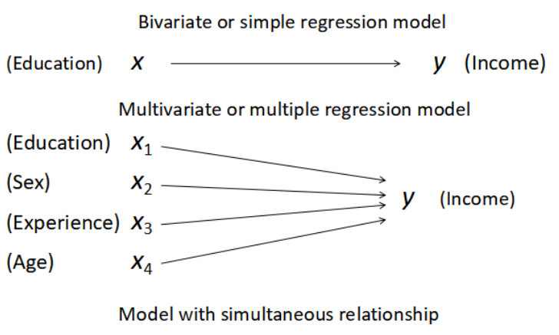
Bivariate and Multivariate Models

Slide 48

Multiple Regression Model
Method for studying the relationship between a dependent variable and two or more independent variables.
Purposes:
Prediction
Explanation (causal)
Theory building
For example, suppose that the effective life of a cutting tool depends on the cutting speed and the tool angle.
A multiple regression model may take the form
where Y: tool life, x₁: cutting speed, x₂: tool angle

Slide 49
Simple vs. Multiple Regression
Simple Regression
One dependent variable Y predicted from one independent variable X
One regression coefficient
r²: proportion of variation in dependent variable Y predictable from X
Multiple Regression
One dependent variable Y predicted from a set of independent variables (X₁, X₂ ….X_{k})
One regression coefficient for each independent variable
R²: proportion of variation in dependent variable Y predictable by set of independent variables (X’s)

Slide 50
Multiple Regression Model
Multiple Regression allows us to:
Use several variables at once to explain the variation in a continuous dependent variable.
Isolate the unique effect of one variable on the continuous dependent variable while taking into consideration that other variables are affecting it too.
Write a mathematical equation that tells us the overall effects of several variables together and the unique effects of each on a continuous dependent variable.
Control for other variables to demonstrate whether bivariate relationships are false

Slide 51
Multiple Regression Model
Regression model for k independent variables:
Estimated intercept
Estimated slope coefficients
Random error variable
Estimated (or predicted)
value of independent variable
Independent variables

Slide 52
Multiple Linear Regression Model
Two variable model
Y
Slope for variable X₁
X₂
Slope for variable X₂
X₁

Slide 53
Multiple Linear Regression
We model the mean of a numeric response as linear combination of the predictors themselves or some functions based on the predictors, i.e.
Y = β_{o} + β₁X₁+ β₂X₂ +…+ β_{p}X_{p}
The regression coefficients (β_{i}) represent the estimated change in the mean of the response Y associated with a unit change in X_{i} while the other predictors are held constant.
They measure the association between Y and X_{i} adjusted for the other predictors in the model.
Here the terms in the model are the predictors

Slide 54
Multiple Linear Regression: 2-Variable Example
A distributor of frozen dessert pies wants to evaluate factors thought to influence demand
Dependent variable: Pie sales (units per week)
Independent variables: Price (in $)
Advertising ($100’s)
Data are collected for 15 weeks

Slide 55
Multiple Linear Regression Equation: 2-Variable Example
Week | Pie Sales | Price ($) | Advertising ($100s)
1 | 350 | 5.50 | 3.3
2 | 460 | 7.50 | 3.3
3 | 350 | 8.00 | 3.0
4 | 430 | 8.00 | 4.5
5 | 350 | 6.80 | 3.0
6 | 380 | 7.50 | 4.0
7 | 430 | 4.50 | 3.0
8 | 470 | 6.40 | 3.7
9 | 450 | 7.00 | 3.5
10 | 490 | 5.00 | 4.0
11 | 340 | 7.20 | 3.5
12 | 300 | 7.90 | 3.2
13 | 440 | 5.90 | 4.0
14 | 450 | 5.00 | 3.5
15 | 300 | 7.00 | 2.7
Multiple regression equation:
Sales = b₀ + b₁ (Price) + b₂ (Advertising)
Sales = b₀ +b₁X₁ + b₂X₂
where X₁ = Price
X₂ = Advertising

Slide 56
Multiple Linear Regression: 2-Variable Example
where
Sales is in number of pies per week
Price is in $
Advertising is in $100’s.
b₁ = -24.975: sales will decrease, on average, by 24.975 pies per week for each $1 increase in selling price, net of the effects of changes due to advertising
b₂ = 74.131: sales will increase, on average, by 74.131 pies per week for each $100 increase in advertising, net of the effects of changes due to price

Slide 57
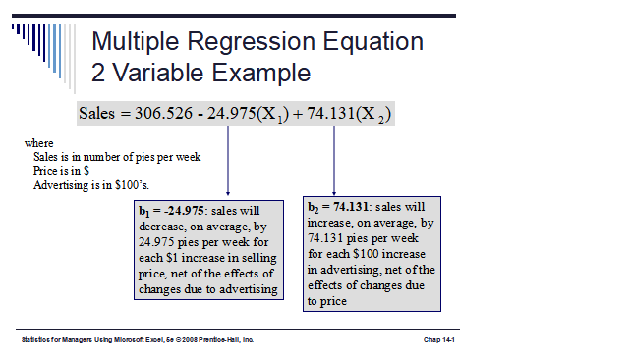
Multiple Linear Regression: 2 Variable Example
Regression Statistics
Multiple R | 0.72213
R Square | 0.52148
Adjusted R Square | 0.44172
Standard Error | 47.46341
Observations | 15
ANOVA | df | SS | MS | F | Significance F
Regression | 2 | 29460.027 | 14730.013 | 6.53861 | 0.01201
Residual | 12 | 27033.306 | 2252.776
Total | 14 | 56493.333
 | Coefficients | Standard Error | t Stat | P-value | Lower 95% | Upper 95%
Intercept | 306.52619 | 114.25389 | 2.68285 | 0.01993 | 57.58835 | 555.46404
Price | -24.97509 | 10.83213 | -2.30565 | 0.03979 | -48.57626 | -1.37392
Advertising | 74.13096 | 25.96732 | 2.85478 | 0.01449 | 17.55303 | 130.70888
Excel will be used to generate the coefficients and measures of goodness of fit for multiple regression

Slide 58
Multiple Linear Regression Equation: 2-Variable Example
Predict sales for a week in which the selling price is $5.50 and advertising is $350:
Note that Advertising is in $100’s, so $350 means that X₂ = 3.5
Predicted sales is 428.62 pies

Slide 59
Example: Where to locate a new motor inn?
La Quinta Motor Inn is planning an expansion. Management wishes to predict which sites are likely to be profitable, defined as having 50% or higher operating margin (net profit expressed as a percentage of total revenue).
Several potential predictors of profitability are:
Competition (room supply)
Market awareness (competing motel)
Demand generators (office and college)
Demographics (household income)
Physical quality/location (distance to downtown)

Slide 60
Operating Margin
Profitability
Competition/
Supply
Market
Awareness
Demand/
Customers
Community
Physical
Rooms
Nearest
Office
Space
College
Enrollment
Income
Disttwn
Number of
hotels/motels
rooms within
3 miles from
the site.
Distance to
the nearest
motel.
Median
household
income.
Distance to
downtown.

Slide 61
Example: Model and Data
Data were collected from 100 randomly-selected inns that belong to La Quinta, and ran for the following suggested model:
Margin = β₀ + β₁ Rooms + β₂ Nearest + β₃ Office +
β₄ College + β₅ Income + β₆ Disttwn + ε

Slide 62
Non-linear Regression

Slide 63
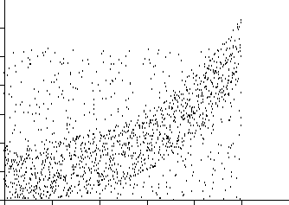
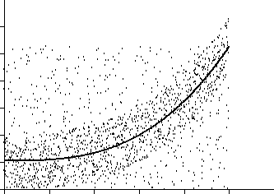
Nonlinear Regression
Nonlinear functions can also be fit as regressions.
Common choices include Power, Logarithmic, Exponential, and Logistic, but any continuous function can be used.
Notes:
https://en.wikipedia.org/wiki/Logistic_function

Slide 64
Linear vs Non-linear Regression
Model the mean of a numeric response Y as a function of a single predictor x, i.e.
Y = β_{o} + β₁f(x)
Here f(x) is any function of x, e.g.
f(x) = x ➔ Y = β_{o} + β₁x (linear)
f(x) = ln(x) ➔ Y = β_{o} + β₁ln(x) (curved - logarithmic)
The key is that Y is a linear in the parameters β_{o} and β₁ but not necessarily in x.

Slide 65
Logistic Regression

Slide 66
Revision: Family of Regression Models
Models relationship between set of variables X_{i}
dichotomous / binomial (yes/no, smoker/nonsmoker,…)
categorical (social class, race, ... )
continuous (age, weight, gestational age, ...)
Response Variable Model Type
Continuous Linear regression (Simple/Multiple)
Binomial Logistic regression

Slide 67
What is Logistic Regression?
Logistic regression is a supervised classification algorithm where the target variable(or output), Y, can take only discrete values for given set of features (or inputs), X.
Target variable, Y is discrete:
binomial/dichotomous : target variable can have only 2 possible types: “0” or “1” which may represent “win” vs “loss”, “pass” vs “fail”, “dead” vs “alive”, etc.
multinomial / categorical: target variable can have 3 or more possible types which are not ordered(i.e. types have no quantitative significance) like “disease A” vs “disease B” vs “disease C”.
ordinal: it deals with target variables with ordered categories. For example, a test score can be categorized as:“very poor”, “poor”, “good”, “very good”. Here, each category can be given a score like 0, 1, 2, 3.

Slide 68
Why use logistic regression?
There are many important research topics for which the dependent variable is "limited."
For example: whether or not a person smokes, or drinks, or skips class, or takes advanced mathematics. For these the outcome is not continuous or distributed normally.
Example: Are mothers who have high school education less likely to have children with IEP’s (individualized plans, indicating cognitive or emotional disabilities)?
Binary logistic regression is a type of regression analysis where the dependent variable is coded 0 (did not smoke) or 1(did smoke): Yes/No, True/False

Slide 69
Logistic Function

Slide 70
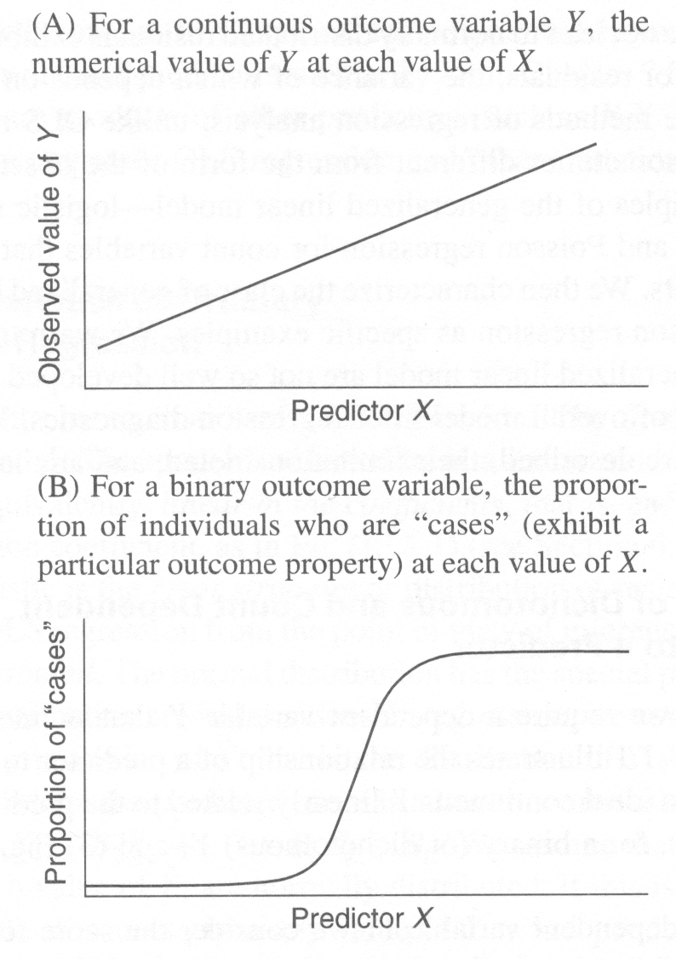
The Logistic Function
Logistic functions model resource limited exponential growth.
Notes:
https://en.wikipedia.org/wiki/Sigmoid_function

Slide 71
Sigmoid Function
A sigmoid function is a mathematical function having a characteristic "S"-shaped curve or sigmoid curve.
Often, sigmoid function refers to the special case of the logistic function S(x).
The sigmoid function is used mostly used in classification type problem since we need to scale the data in some given specific range with a threshold.

Slide 72
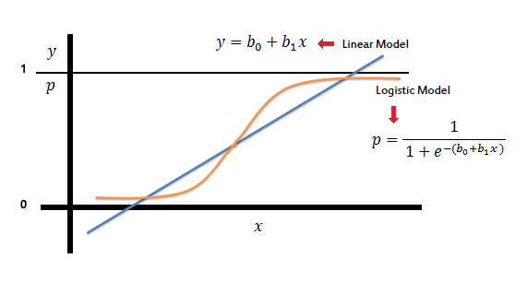
More about Logistic Regression
https://www.youtube.com/watch?v=nz-FrbAa8dY
https://en.wikipedia.org/wiki/Logistic_regression
https://machinelearningmastery.com/logistic-regression-tutorial-for-machine-learning/

Slide 73
Conclusion
Regression is the attempt to explain the variation in a dependent variable using the variation in independent variables.
Simple Regression Model: Consider a model with only one independent variable.
Multiple Regression Model: A model with more than one independent variables.
Logistic regression: the target variable(or output), Y, can take only discrete values for given set of features(or inputs), X.

Slide 74
Main References
Harrington, P (2012). Machine Learning in Action. Manning Publications.
Richert, W. and Coelho, L.P. (2013). Building Machine Learning Systems with Python. Packt Publishing.
Witten, I.H, Franck, E, and Hall, M. A. (2011). Data Mining: Practical Machine Learning Tools and Techniques. (3rd ed.). Morgan Kaufmann.
Pang-Ning Tan, Michael Steinbach, Anuj Karpatne, Vipin Kumar (2018). Introduction to Data Mining (2nd Edition), Pearson

Slide 75
Other References
J. Grus (2015). Data Science from Scratch: First Principles with Python. O'Reilly Media.
C. C. Aggarwal. (2015). Data Mining: The Textbook. Springer
Richert, W. and Coelho, L.P. (2013). Building Machine Learning Systems with Python. Packt Publishing.
Russel M.A. (2013). Mining the Social Web: Data Mining Facebook, Twitter, LinkedIn, Google+, GitHub, and More. (2nd Ed). O’Reilly Media.

Slide 76
Online References
https://www.geeksforgeeks.org/linear-regression-python-implementation/
https://www.spss-tutorials.com/multiple-linear-regression/

